Slide 1
How to Create your account username and password (fsa ID): An Overview

Slide 2
Topics Covered
01 What is an account username and password?
02 Do parents need an account username and password?
03 How do you create your account username and password?\
04 Where can you use your account username and password?
05 Where to get more information

Slide 3
What is an account Username and password?
An account username and password is used by students, parents, and borrowers to log in to U.S. Department of Education online systems and to electronically sign documents.
You use it to
  apply for federal student aid;
  access the myStudentAid mobile app;
  sign for a federal student loan; and
  perform important activities such as choosing a repayment plan or applying for a deferment on your federal student loan.

Slide 4
Do parents need an account username and password?
If you’re a dependent student, then your parent will need an account username and password in order to sign your Free Application for Federal Student Aid (FAFSA®) form electronically.
Not sure if you’re considered a dependent student for FAFSA purposes? Go to StudentAid.gov/dependency to find out.
IMPORTANT
You and your parent must have different account usernames and passwords (NOTE: A Social Security number can be associated with only one account username and password).
You must create your own account username and password—it’s your electronic signature and you need to own it.
Your parent must create his or her own account username and password.
You and your parent should each use your own email address and mobile phone number when creating an account username and password (NOTE: A mobile phone or an email address can be associated with only one account username and password).

Slide 5
How do you create your account username and password?

Slide 6
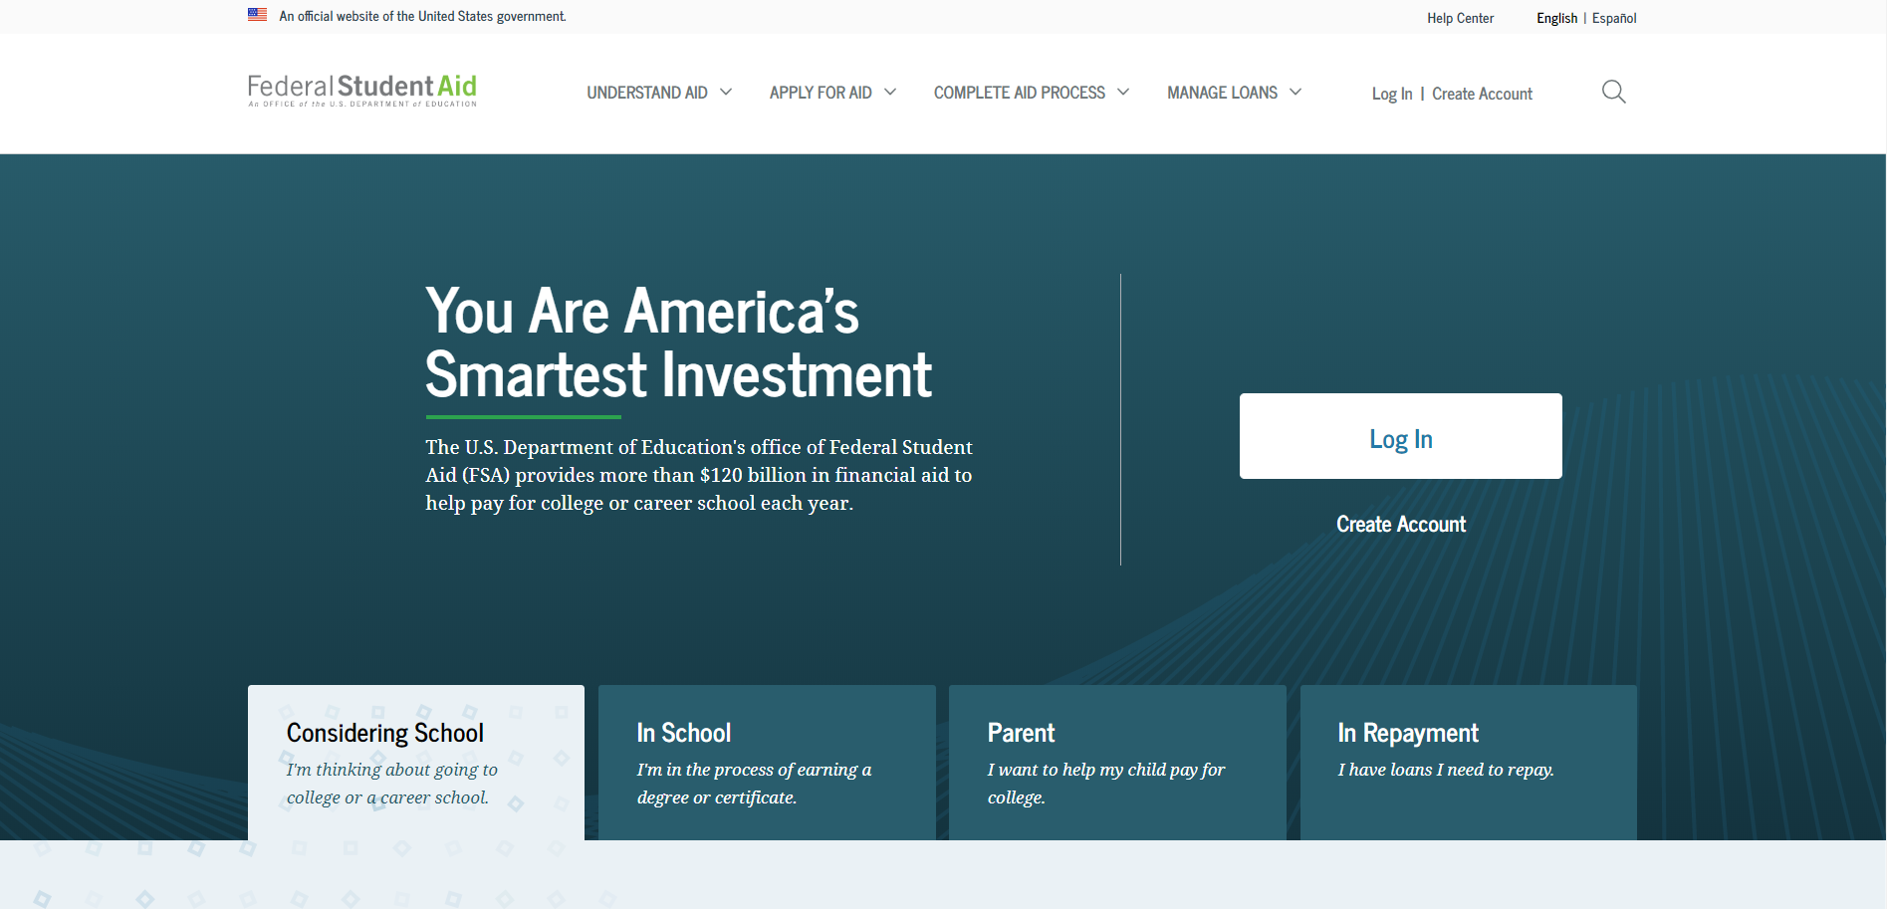
Getting started
Go to StudentAid.gov.
Select the “Create Account” button

Slide 7
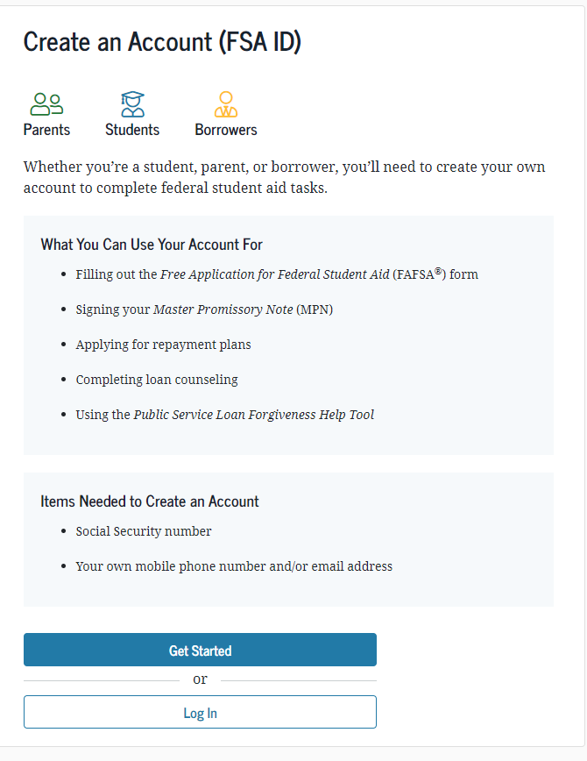
Getting started
On the “Create an Account (FSA ID)” page, select the “Get Started” button.

Slide 8
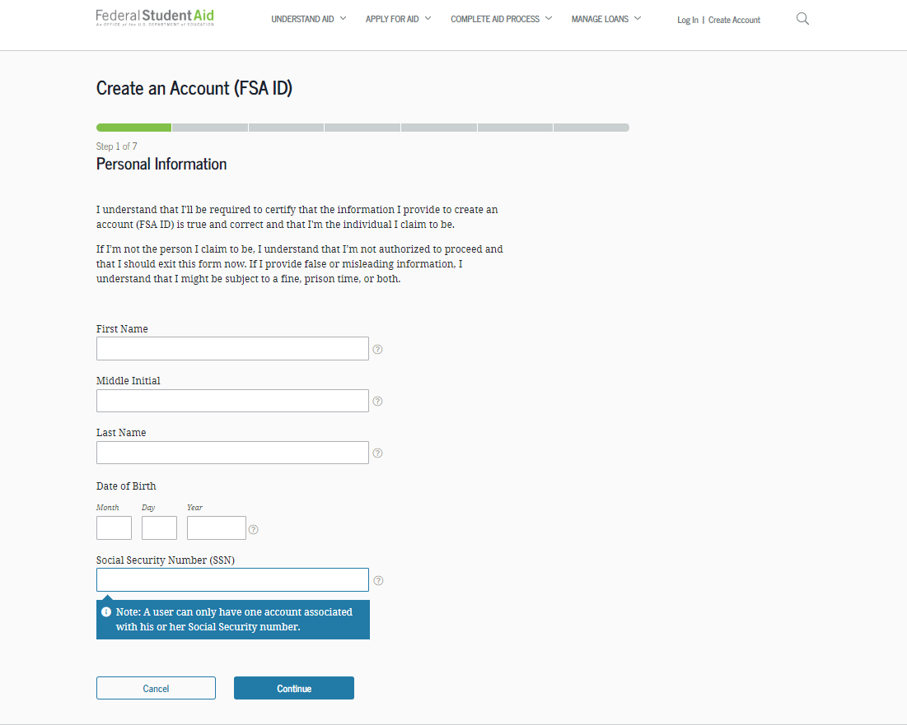
Provide Personal Identification Information
Make sure your Social Security number (SSN), date of birth, and name match what’s on your Social Security card.
You must have an SSN to create an account username and password.

Slide 9
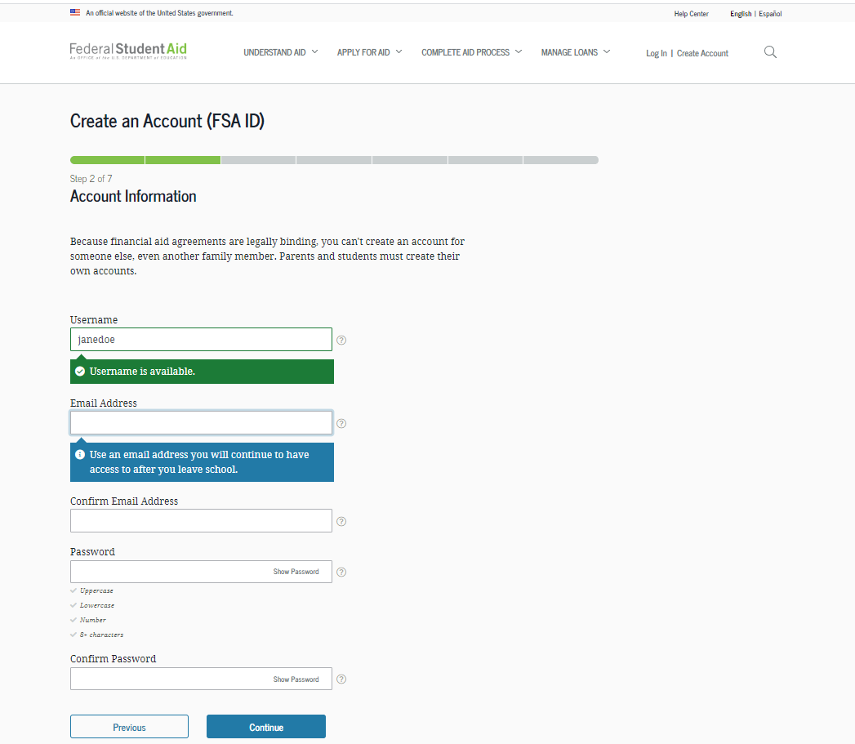
Create Your account username and password
Username:
Don’t include personal info such as date of birth or name.
If you see a message “The username you entered is already in use,” then someone has already used that username.
Password:
Your password must be between 8 and 30 characters in length, and must contain at least one uppercase letter, one lowercase letter, and one number.
Your password is case-sensitive.

Slide 10
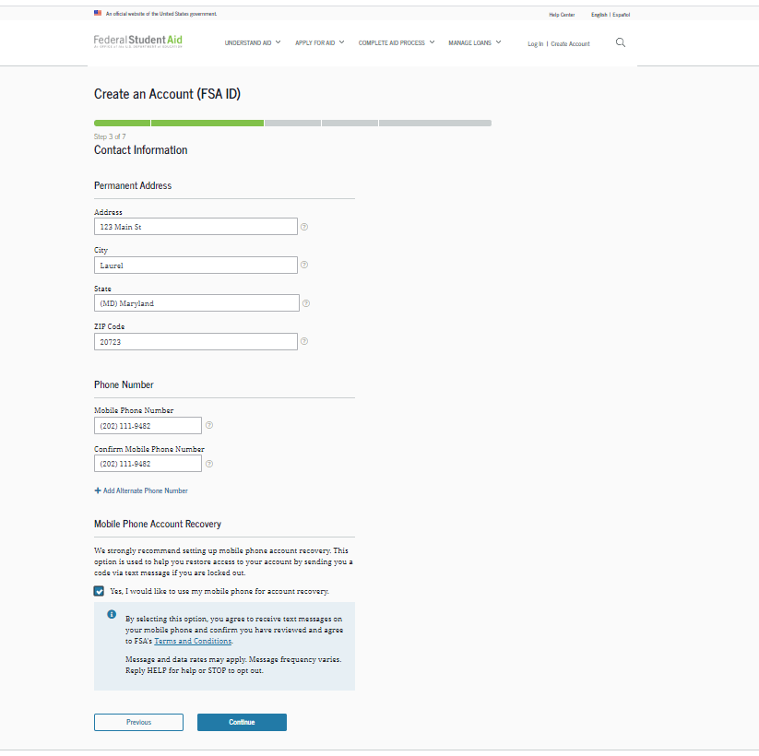
Provide Contact information
To sign up for mobile phone account recovery, provide a mobile phone number on this screen.
Make sure your information is correct; any errors could result in delays in receiving financial aid (or in the repayment of your federal student loans).

Slide 11
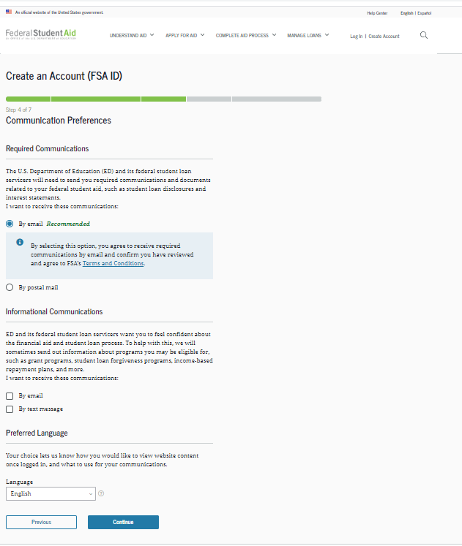
Select communication preferences
You must select whether to receive required communications by email or postal mail.
You can opt in to receive informational emails and/or text messages regarding programs you may be eligible for.

Slide 12
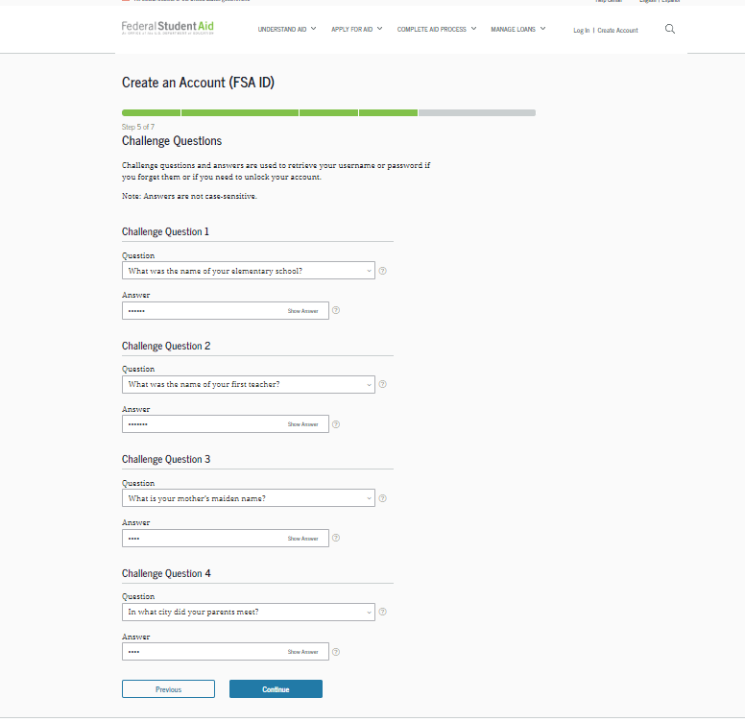
Select challenge questions and answers
Answering your challenge questions is one way to unlock your account or retrieve your username or password.
Your answer is not case-sensitive.

Slide 13
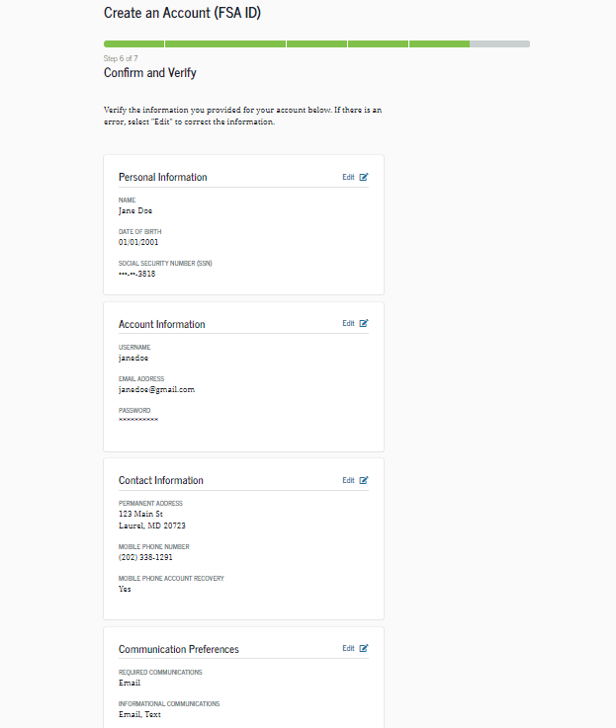
Review Info and Agree to Terms
Review and confirm your information.
If you need to make a correction, use the “Edit” button within that tile of information.
Review and agree to FSA’s terms and conditions.

Slide 14
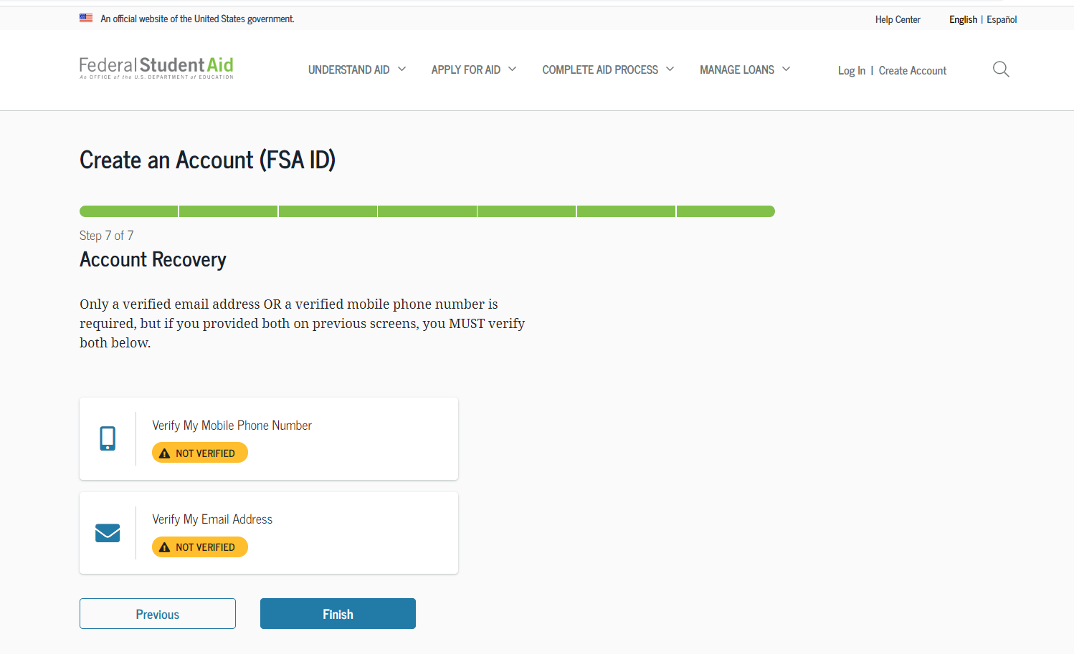
Verify your contact information
Only a verified email address OR a verified mobile phone number is required, but if you provided both on previous screens, you MUST verify both on the “Account Recovery” page.
Select the “Verify My Mobile Phone Number” button to verify your mobile phone number.
Select the “Verify My Email Address” button to verify your email address.

Slide 15
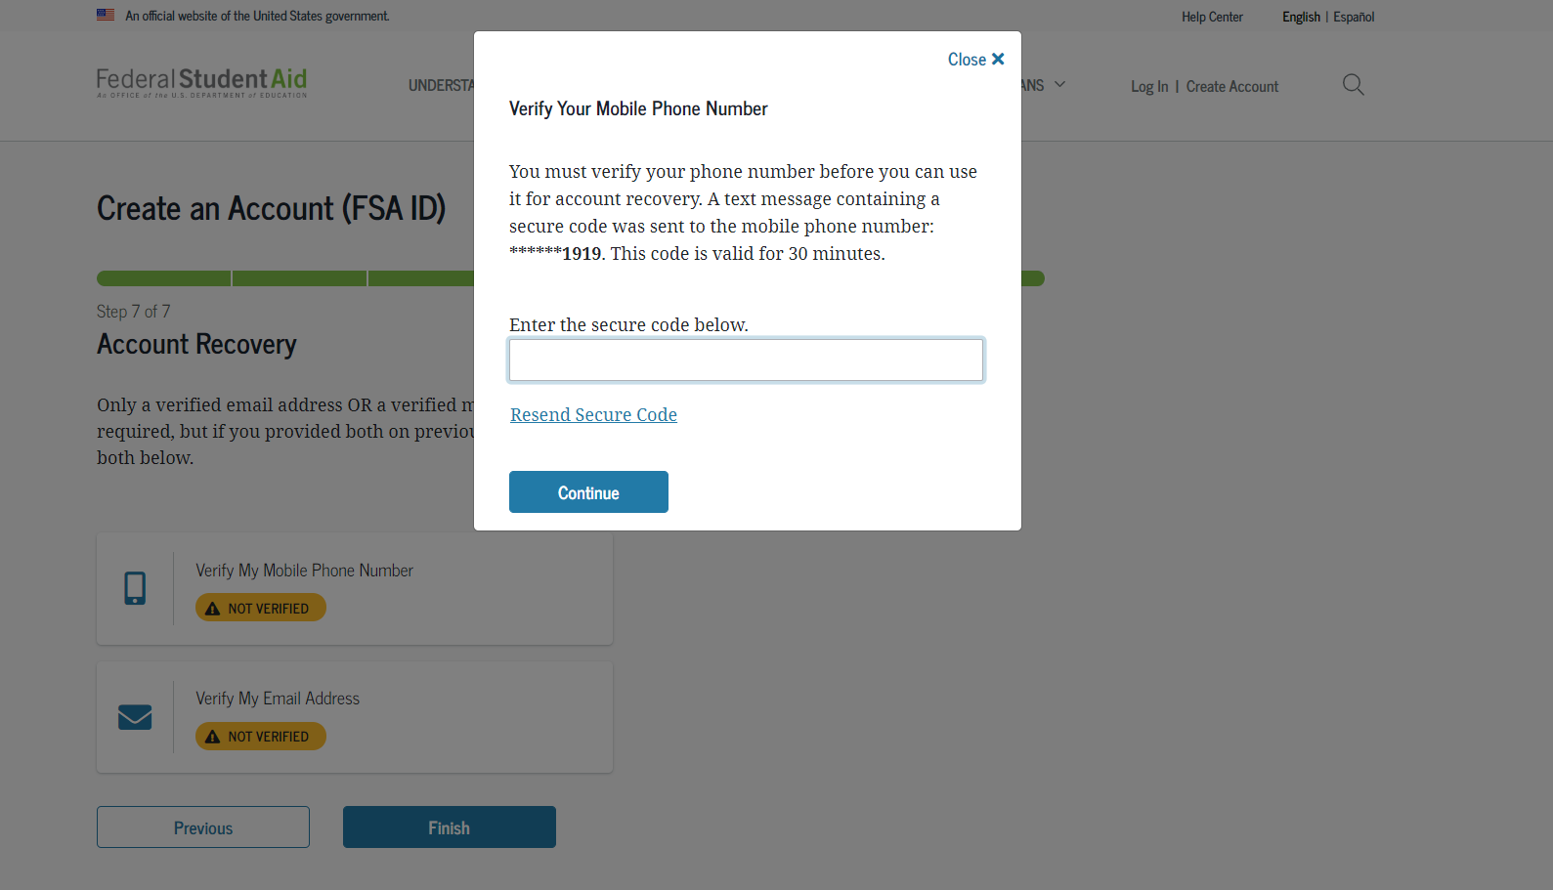
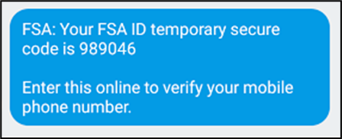
Verify your mobile phone number
After selecting the “Verify My Mobile Phone Number” button, you will be sent a text message with the six-digit numerical secure code.
Enter your secure code in the “Verify Your Mobile Phone Number” modal and select “Continue”.
Once you verify your mobile phone number, you can use it to log in, unlock your account, retrieve your username, or reset your password.
NOTE: You MUST verify your information before continuing.
Text Message With Your Secure Code

Slide 16
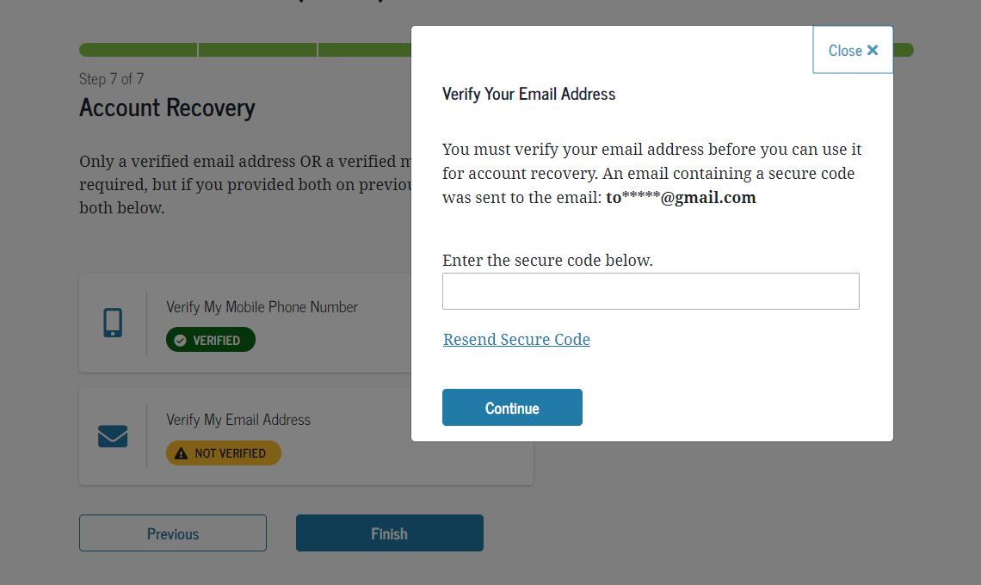
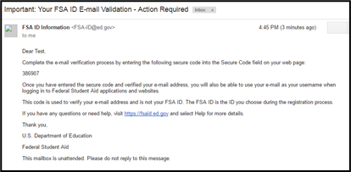
Verify your Email address
After selecting the “Verify My Email Address” button, you will be sent an email with the six-digit numerical secure code.
Enter your secure code in the “Verify Your Email Address” modal and select “Continue”.
Once you verify your email, you can use it to log in, unlock your account, retrieve your username, or reset your password.
NOTE: You MUST verify your information before continuing.
Email With Your Secure Code

Slide 17
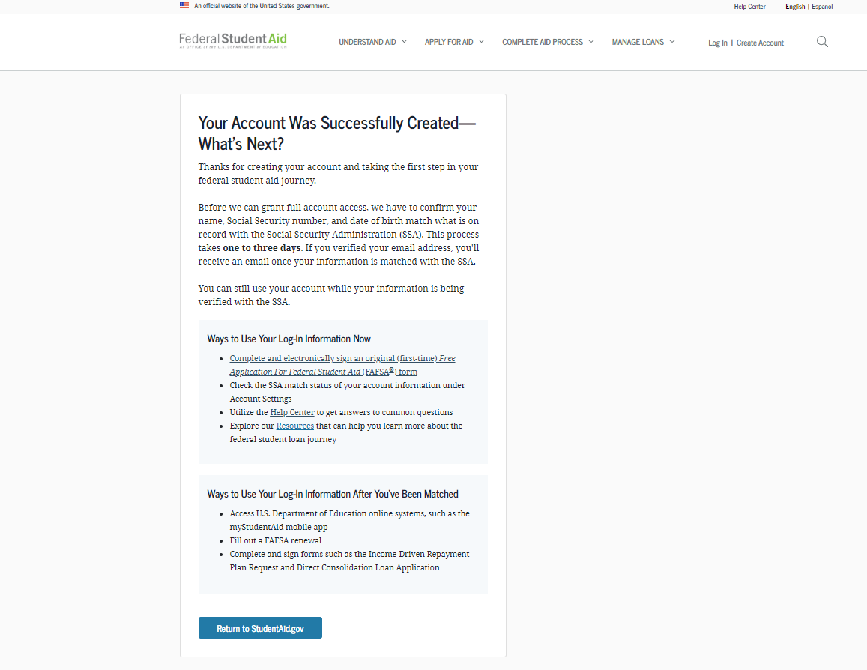
Your account is created!
If you provided an email address, you’ll receive a confirmation email.
Using Your Account Username and Password
You can immediately use your account username and password to sign an original (first-time) FAFSA form.
Your info will be sent to the Social Security Administration (SSA) for confirmation.
SSA review will take 1–3 days.
Until your info is verified, you won’t be able to take certain actions, such as correcting your FAFSA form, submitting a FAFSA Renewal, or signing forms such as the Income-Driven Repayment Plan Request and Direct Consolidation Loan Application.

Slide 18
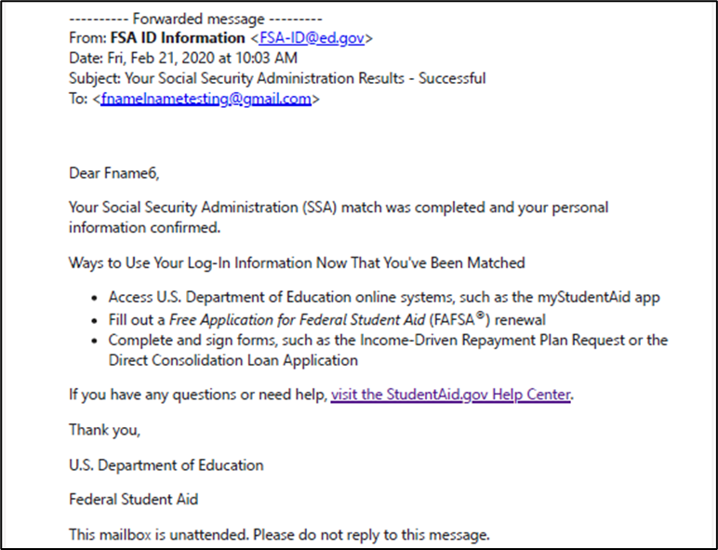
Social security administration (ssa) matching
You should receive an email informing you of the results of the SSA review. If you didn’t provide an email when creating your account, you can check the status on the "Personal Information” page at StudentAid.gov\settings\edit-information\personal-information.
If there is an issue, log in to your “Account Settings” at StudentAid.gov/settings and review/update your profile info. If your info is correct, you’ll need to contact the SSA. To find your local SSA office, call 1-800-772-1213 or go to ssa.gov.

Slide 19
Where can you use your account username and password?

Slide 20
Using your account username and password
Online Systems | What You Can Do
StudentAid.gov | Complete entrance counseling, the Financial Awareness Counseling tool, or exit counseling Electronically sign a Master Promissory Note Sign your Agreement to Service for the Teacher Education Assistance for College and Higher Education (TEACH) Grant Program Complete PLUS loan requests Estimate your student loan payments using the Loan Simulator Apply for an income-driven repayment plan or a consolidation loan View a history of any federal student aid that you have received Look up your loan servicer's contact information
myStudentAid app | Electronically sign your (or your child’s) FAFSA form Fill out a FAFSA Renewal Manage your FSA ID View your federal student aid history using the myFederalLoans service
fafsa.gov | Electronically sign your (or your child's) FAFSA form Prefill data in this year´s FAFSA form if you filed a FAFSA form last year (FAFSA Renewal) Make online corrections to an existing FAFSA form View or print an online copy of your Student Aid Report (SAR)

Slide 21
Where to get more information

Slide 22
Where to get more information
Additional details on account username and password, including answers to frequently asked questions and tips on creating an account username and password, can be found in the Help Center under the “Managing Your Account” section at StudentAid.gov\help-center\answers\topic\managing_your_account\articles.

